Slide 1
Edge-detection algorithms

Slide 2
Edge detection is one of the most important areas in lower level computer vision
Edge detection is important because the success of higher level processing relies heavily on good edges

Slide 3

Edge Detection
Edge easy to find

Slide 4

Where is edge? Single pixel wide or multiple pixels?

Slide 5
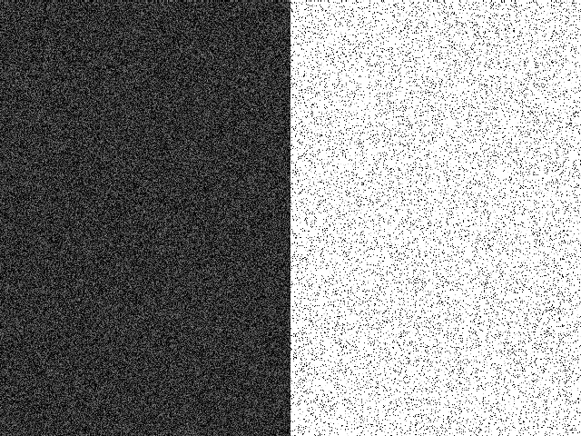
Noise: have to distinguish noise from actual edge

Slide 6
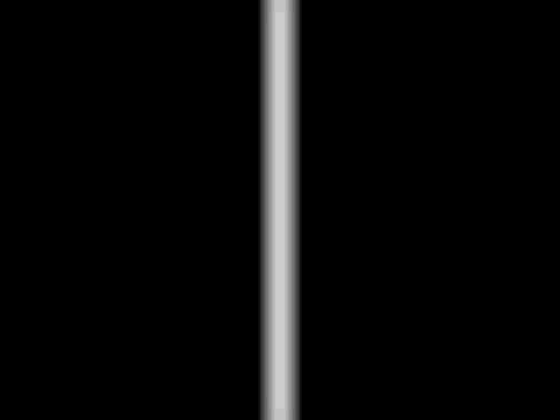
Is this one edge or two?

Slide 7
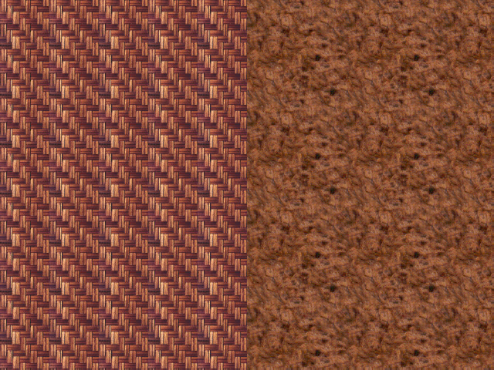
Texture discontinuity

Slide 8
Three stages in edge detection
1- Filtering to remove the noise
2- Differentiation highlights the locations in the image where intensity changes are significant
3- Detection, detect those points where the intensity changes are significant

Slide 9
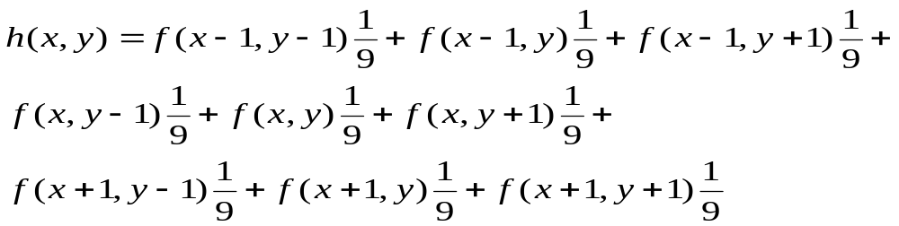
1-Filtering Stage
The most simple filter is the mean filter
In the mean filter, the gray level at each picture element pixel is replaced by the mean of gray levels in a small neighborhood around the pixel
Let f denote the image which we want to filter, h denote the filtered image. Consider a 3x3 neighborhood around a pixel. Then:

Slide 10
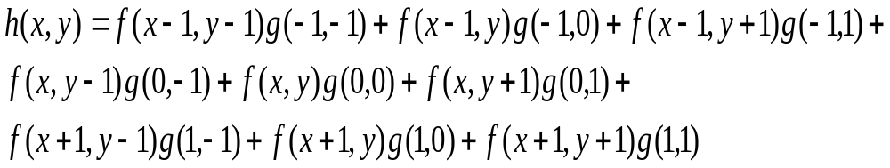
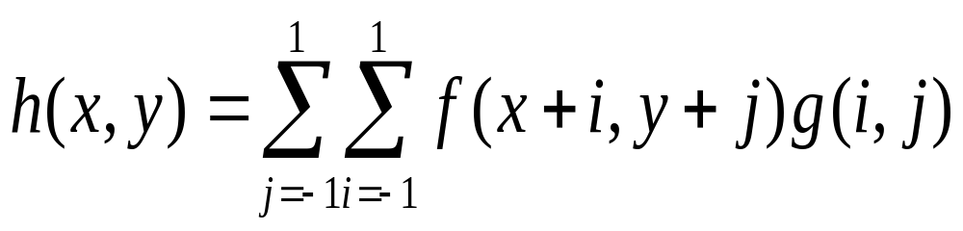
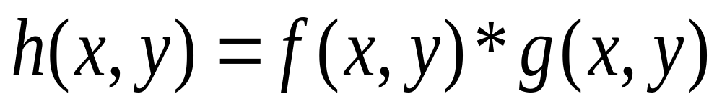
Here g denote the filter and * denotes the convolution operation. The filter in this case is 3x3 and each pixel in the filter is set to 1/9
The filter g is convolved with the image f and the result is a filtered image h

Slide 11
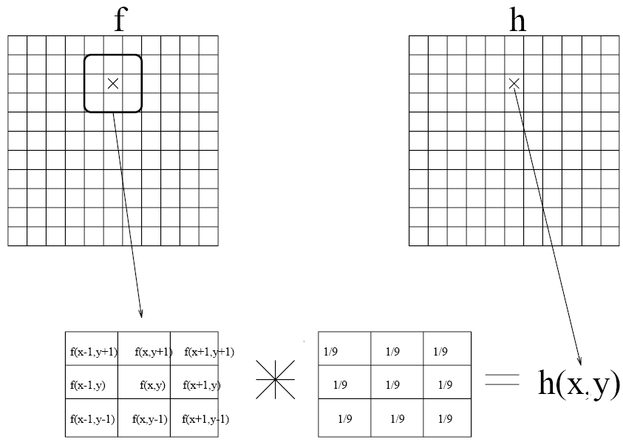
The convolution operation is widely used in Computer Vision and Image Processing.
The convolution operation can be visualized as passing around a filter mask g in the image from left to right top to bottom as shown in following Figure.
The mean filter performs equal averaging each pixel value around a small neighborhood is assigned equal weight

Slide 12
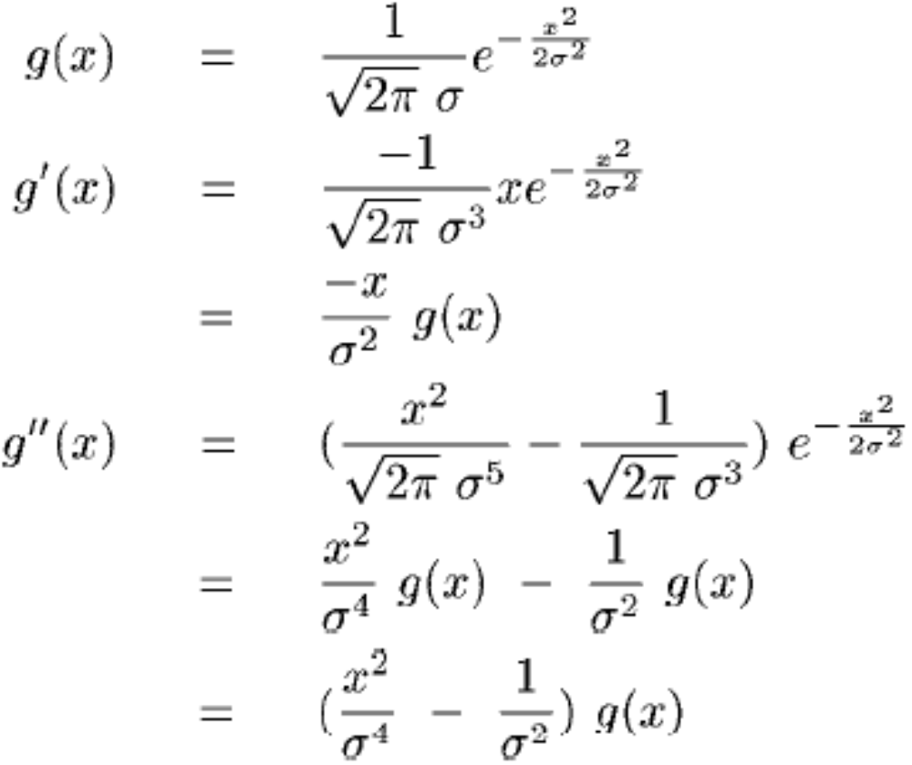
Gaussian

Slide 13
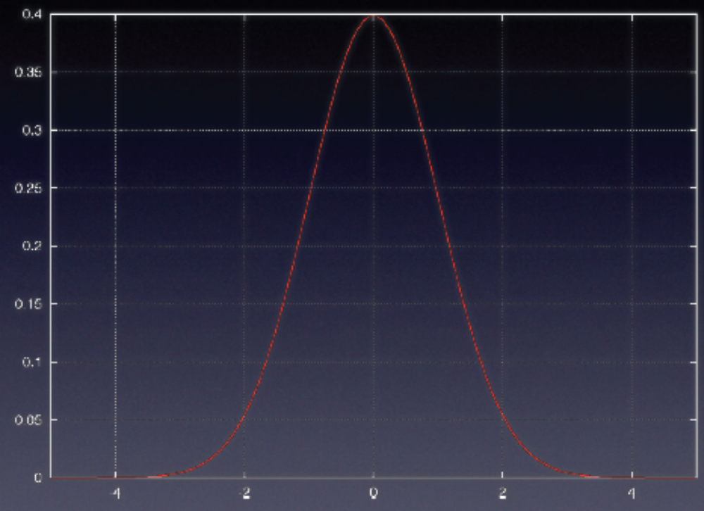
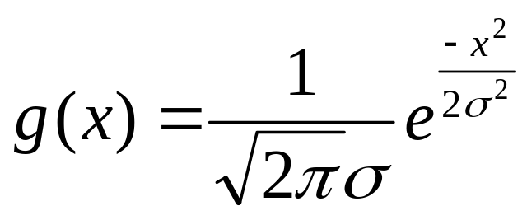

Slide 14
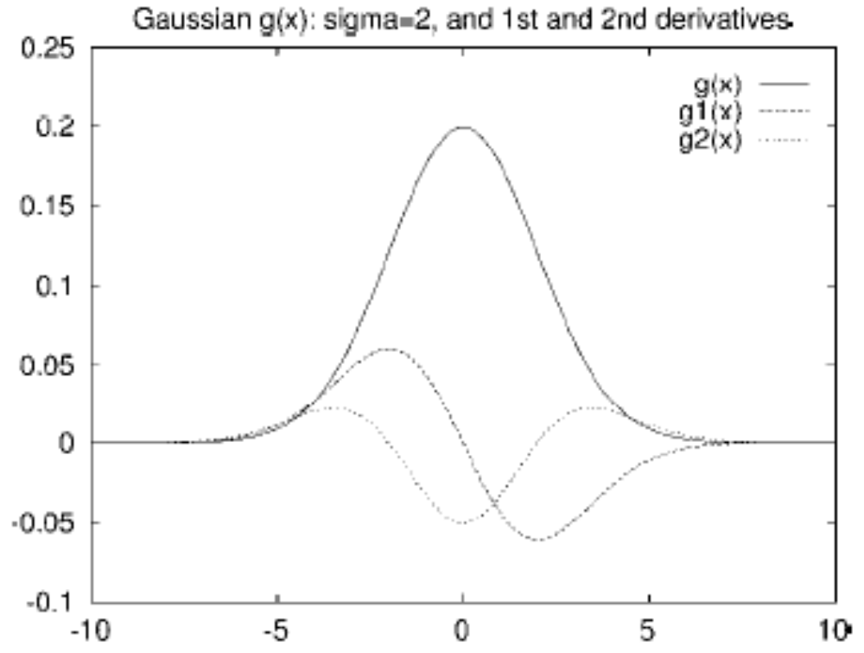
The second derivative form is well known "Mexican hat".

Slide 15
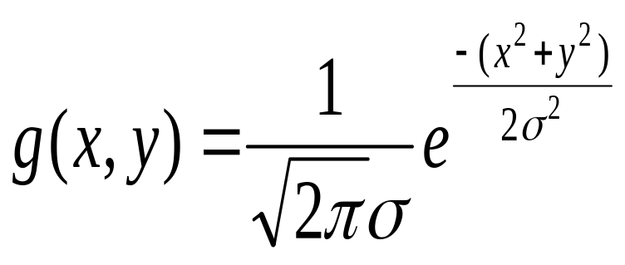
In the Gaussian filter each pixels weight is inversely proportional to the distance from the central pixel
The Gaussian is defined as
where σ is the standard deviation of Gaussian and controls the mask size.

Slide 16
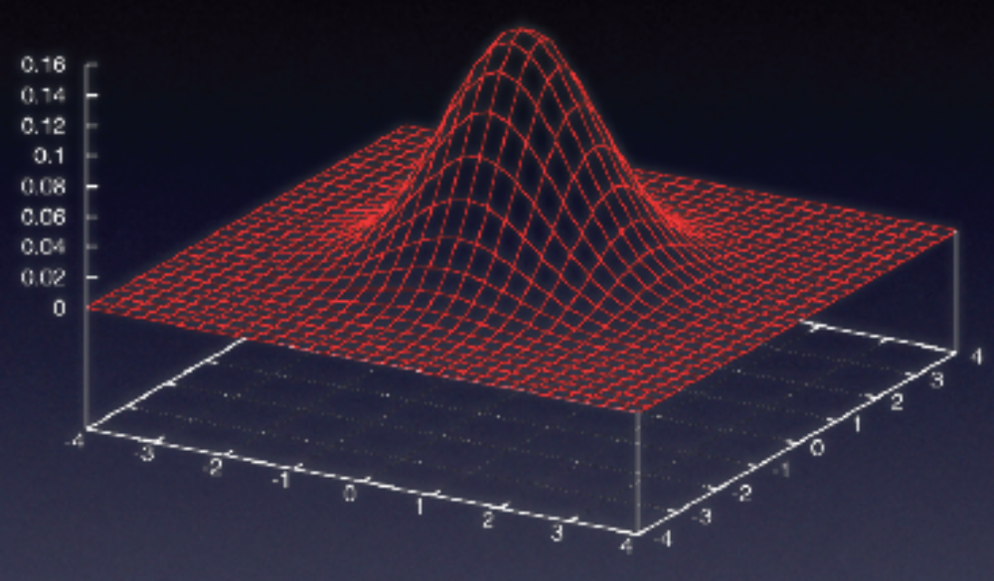

Slide 17
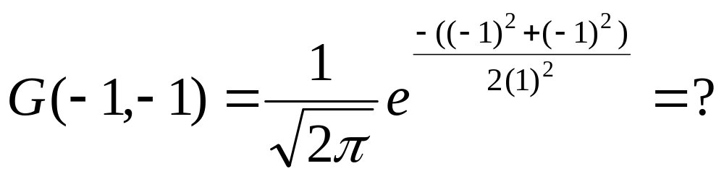
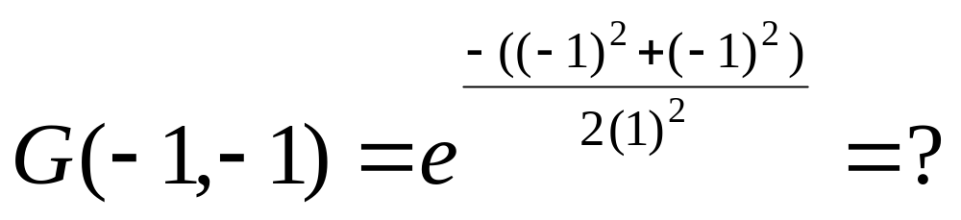
The mask of g(x,y) can be generated for a given value of σ by taking various values of x and y and substituting in the above formula For example with x=-1, y=-1, and σ =1

Slide 18
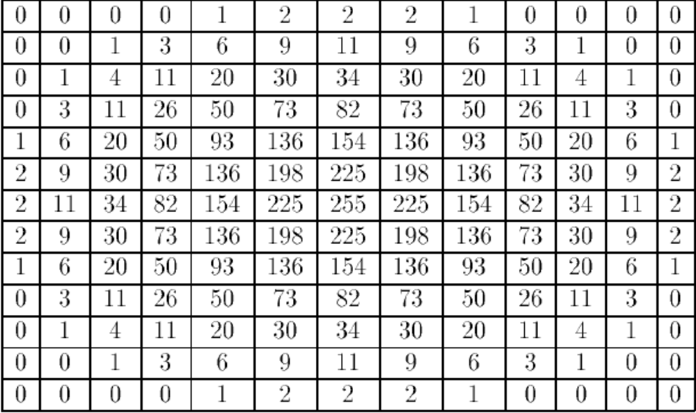
Because the image gray levels are integers, it is simpler to perform integer multiplication as compared to real number multiplications.
  The mask of the Gaussian filter for σ=2 multiplied by 255 and truncated to the nearest integer is shown in the figure
Note that this is a 13x13 mask. For values x, y>|6| the G(x, y) is very small Therefore those values have been ignored.
Since the Gaussian function becomes less than 1% of its maximum value for x, y> 3σ. It is appropriate to use a mask size of at least 6σ+1.

Slide 19
Median Filter
Definition:Let A[i] i=0...(n-1) be a sorted array of n real numbers. The median of the set of numbers in A is A[(n-1)/2]
For odd n, the array has a unique middle as defined above.
If n is even, then we can define that there are two medians, at A[n/2] and A[n/2 -1], or one median, which is the average of these two values.

Slide 20
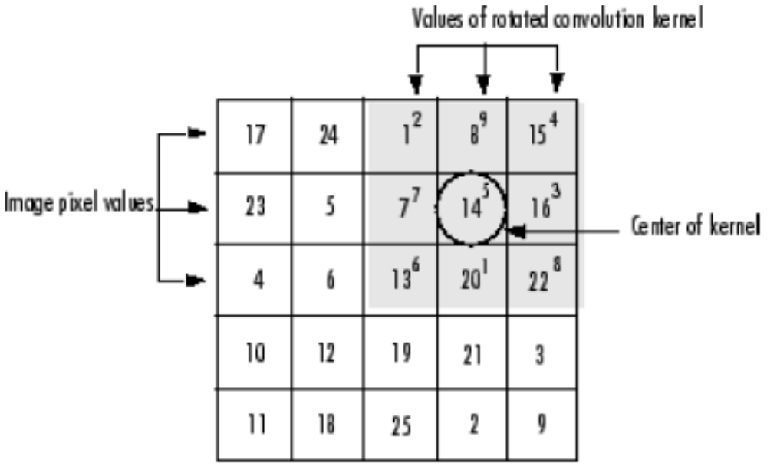
Convolution & Correlation
Convolution
convolution kernel is
h = [8 1 6
3 5 7
4 9 2]
Rotate the convolution kernel 180 degrees about its center element

Slide 21
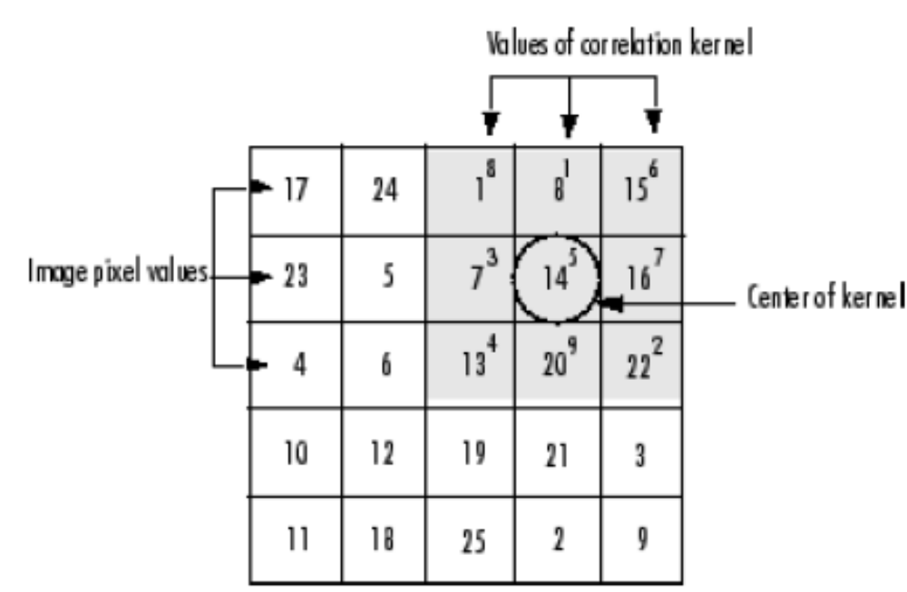
Correlation
correlation kernel is
h = [8 1 6
3 5 7
4 9 2]
No rotation of the correlation kernel

Slide 22
A = magic(5)
17 24 1 8 15
23 5 7 14 16
4 6 13 20 22
10 12 19 21 3
11 18 25 2 9
h = [-1 0 1]
imfilter(A,h) % filter using correlation
24 -16 -16 14 -8
5 -16 9 9 -14
6 9 14 9 -20
12 9 9 -16 -21
18 14 -16 -16 -2
imfilter(A,h,'conv') % filter using convolution
-24 16 16 -14 8
-5 16 -9 -9 14
-6 -9 -14 -9 20
-12 -9 -9 16 21
-18 -14 16 16 2

Slide 23
MATLAB has several two-dimensional and multidimensional filtering functions.
  The function filter2 performs two-dimensional correlation,
  conv2 performs two-dimensional convolution, and
  convn performs multidimensional convolution.
conv2 and conv filtering functions always converts the input to double, and the output is always double.
conv2 and conv filtering functions always assume the input is zero padded, and they do not support other padding options.
The imfilter function does not convert input images to double.
The imfilter function also offers a flexible set of boundary padding options,

Slide 24
**Presentation Assignment
Use Examples!
Add noise using imnoise (gaussian, salt & pepper, poisson, and speckle)
  Example
    I = imread('eight.tif');
    J = imnoise(I,'salt & pepper', 0.02);
    imshow(I), figure, imshow(J)
Filtering using filter2, medfilt2 (Median), wiener2 (adaptive)
  Example
    I = imread('eight.tif');
    J = imnoise(I,'salt & pepper',0.02);
    K = medfilt2(J);
    imshow(J), figure, imshow(K)

Slide 25
**Presentation Assignment
Use Examples!
>>conv?
>>conv2?
>>fspecial?
>>imfilter?

Slide 26
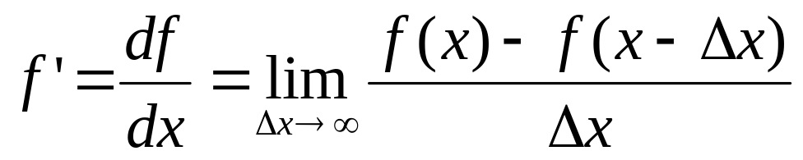
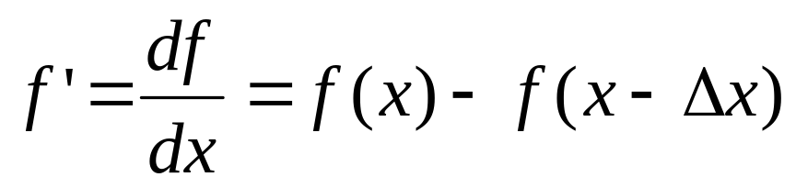
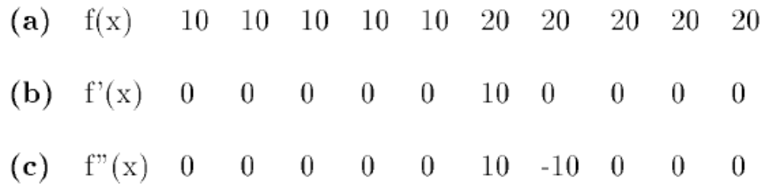
2-Differentiation Stage
The derivative of a continuous function f is defined as:
Since images are discrete the minimum value of Δx can be 1. Now the above formula reduces to

Slide 27
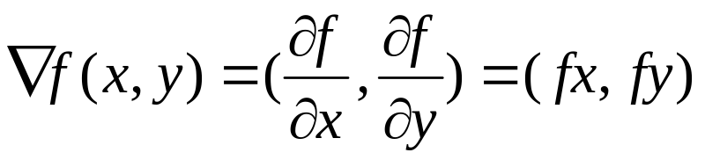
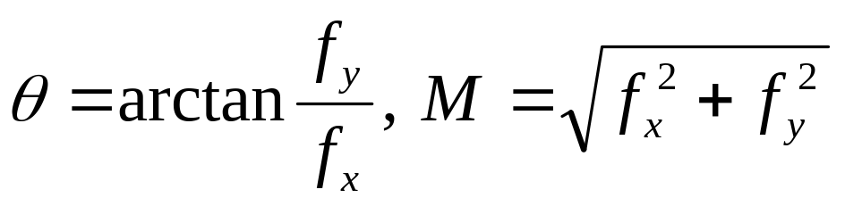
(a)
(b)
(c)
Derivative masks
Note that the derivative can be computed by applying a mask to f similar to filtering an image.
What is derivative in 2-D? Gradient:
  where fx is the derivative in the x direction,
  and fy is the derivative in the y direction
  The gradient has magnitude M and direction θ as defined below:

Slide 28
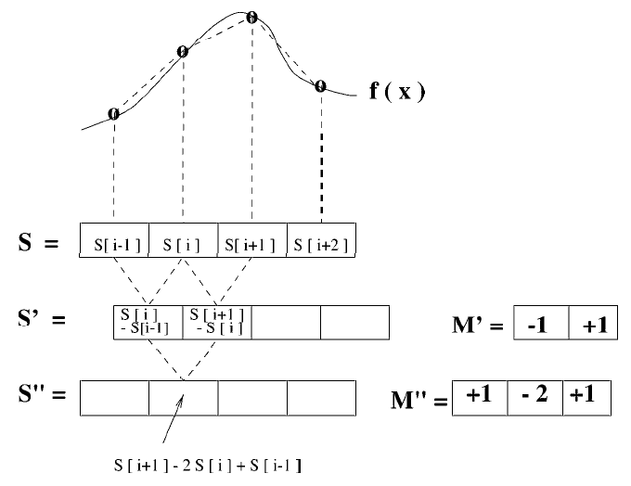

Slide 29
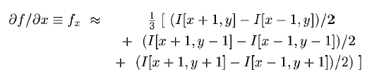
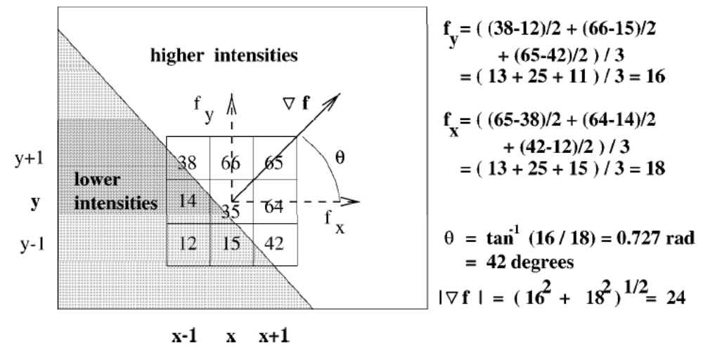

Slide 30
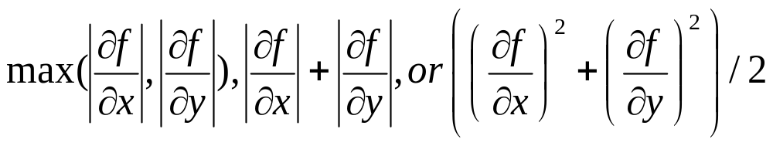
It is common to avoid computing a square root in order to compute gradient magnitude; alternatives are

Slide 31
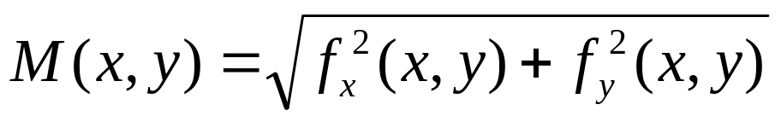
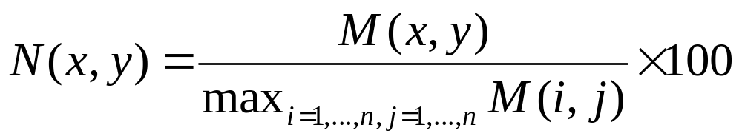
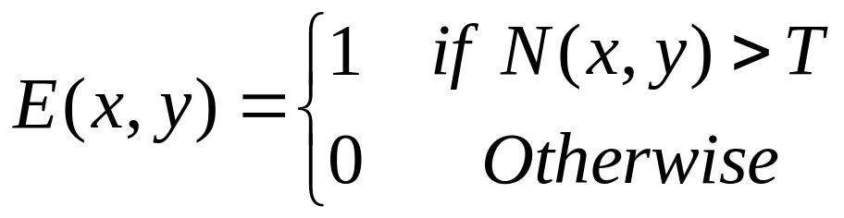
3-Detection Stage
Normalized Gradient Magnitude
Let
be a gradient magnitude at pixel (x, y). Define N(x, y) as the normalized gradient magnitude scaled between 0 to 100 as follows:
Then edges can be detected by applying a threshold T on the normalized gradient magnitude N

Slide 32
Edge-detection algorithms
Sobel
Prewitt
Roberts
Canny
Laplacian of Gaussian
>> edgedemo

Slide 33
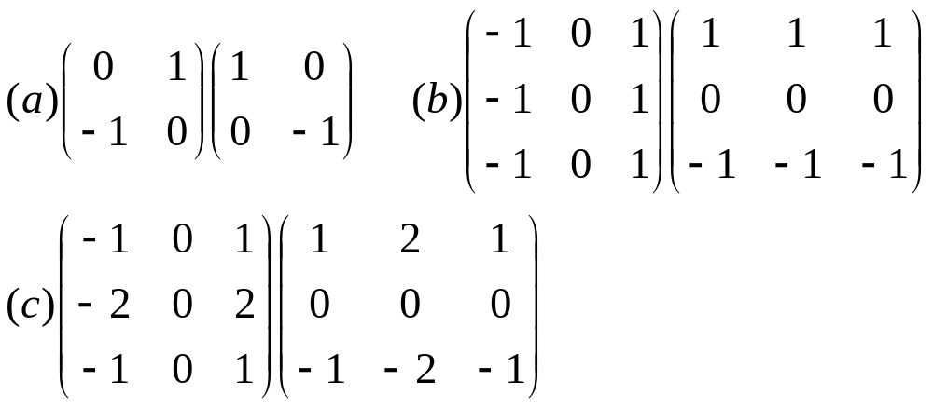
بيطبقها في اتجاه
(X)
بيطبقها في اتجاه
(Y)
Classical Operators
  (a) Robert’s operator
  (b) Prewit’s operator
  (c) Sobel’s operator

Slide 34
Robert, Prewit, and Sobel operators essentially compute the gradient at a pixel location along the principle directions.
The most common directions are X and Y but diagonal and antidiagonal directions have also been used.

Slide 35
The Sobel method finds edges using the Sobel approximation to the derivative. It returns edges at those points where the gradient of I is maximum.
The Prewitt method finds edges using the Prewitt approximation to the derivative. It returns edges at those points where the gradient of I is maximum.
The Roberts method finds edges using the Roberts approximation to the derivative. It returns edges at those points where the gradient of I is maximum.
The Laplacian of Gaussian (LOG) method finds edges by looking for zero crossings after filtering I with a Laplacian of Gaussian filter.

Slide 36
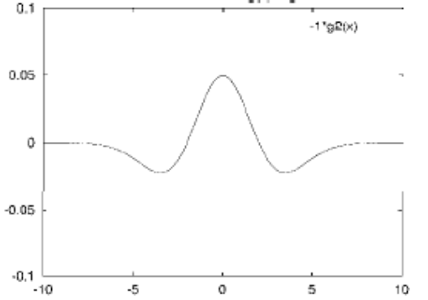
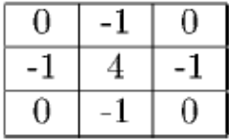
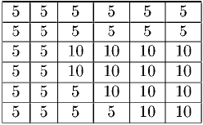
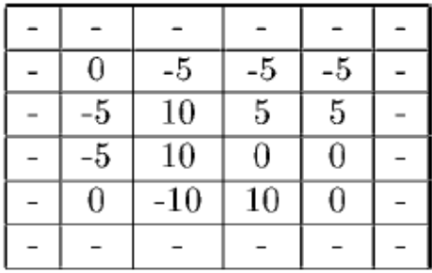
Laplacian of Gaussian (LOG)
3x3 mask approximating the LOG filter
Cross section of the LOG filter
input image
result of applying the mask to it

Slide 37
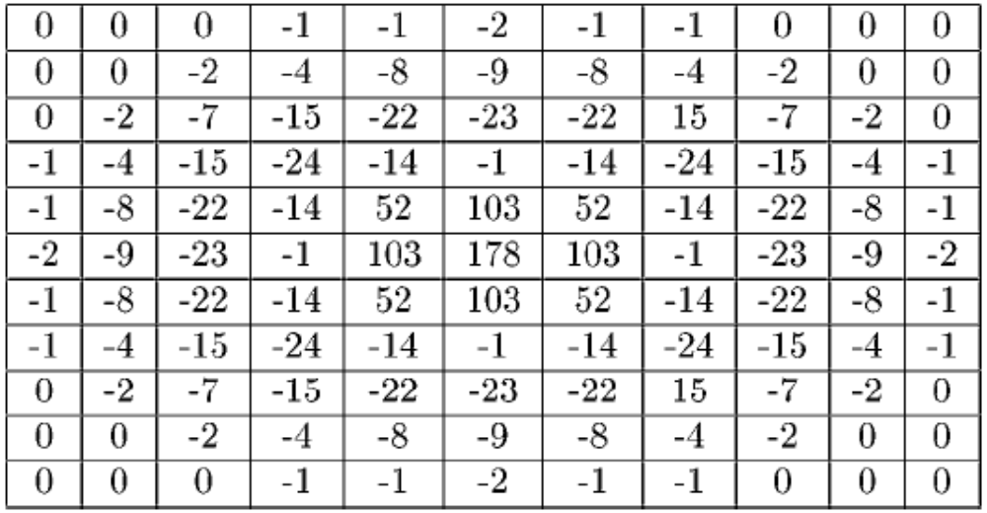

Slide 38
Canny edge detector
Smooth, smooth with a Gaussian of some width σ
Find derivative, “Gradient”
Find maxima
  Eliminate all but local maxima in magnitude of gradient
  Threshold: use two thresholds
    Find chains of edge pixels, all greater than t1
    Each chain must contain at least one pixel greater than t2

Slide 39
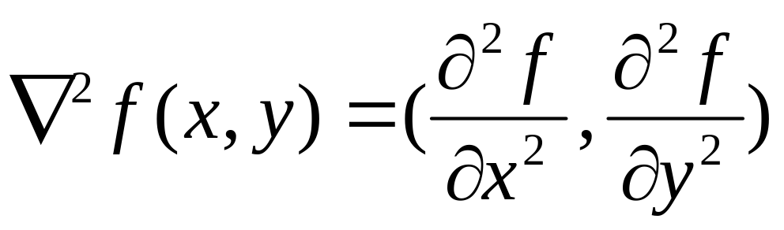
Second-order edge detectors
To find local maxima in derivative, look for
zeros in second derivative
Laplacian
Higher-order derivatives = greater noise sensitivity

